Slide 1

Seasonal Agriculture Performance Analysis
C PUSHPALATHA
Justice Basheer Ahmed Sayeed College for Women
AICTE STU ID : STU696132c929d891767977673

Slide 2

PROBLEM STATEMENT
(Agricultural activities are influenced by seasonal variations in environmental conditions, farming practices, resource availability and market conditions. As a result, agricultural performance may differ from one season to another. However, raw agricultural data does not clearly explain how agricultural performance changes across seasons or what patterns can be observed in different seasonal conditions. The problem is to analyze the given agricultural dataset and investigate seasonal differences in agricultural performance by identifying meaningful patterns, trends, relationships and variations within the available data.

Slide 3
Project Description
Seasonal Agriculture Performance Analysis is a data analytics project focused on understanding how agricultural performance varies across different seasons, regions, crops, environmental conditions, farming practices, resource usage, and economic factors. The project involves data loading, data cleaning, exploratory data analysis, statistical analysis, KPI evaluation, visualization, and interpretation of agricultural data. The analysis compares seasonal performance, crop productivity, resource usage, environmental conditions, and economic outcomes to identify meaningful patterns and relationships. The objective is to generate evidence-based insights and data-driven recommendations that can support better seasonal agricultural planning and resource management.

Slide 4

WHO ARE THE END USERS?
Farmers – to understand which seasons, crops, and farming conditions give better performance.
Agricultural Planners & Departments – to support seasonal agricultural planning and resource allocation.
Agricultural Researchers – to study seasonal patterns, crop performance, and environmental relationships.
Agribusinesses & Agritech Companies – to understand crop production, resource usage, and profitability patterns.
Government & Policy Makers – to support evidence-based agricultural policies and programs.
Agricultural Consultants – to provide data-driven recommendations to farmers and agricultural organizations.

Slide 5

Technology Used
Python – Data cleaning, preprocessing, analysis, and visualization
Pandas & NumPy – Data manipulation and numerical analysis
Matplotlib & Seaborn – Exploratory data analysis and visualization
Jupyter Notebook – Analysis documentation and execution
SciPy – Statistical analysis and ANOVA
CSV – Dataset and data storage format
GitHub – Project documentation and version control

Slide 6
RESULTS
Dataset Overview
• Total Records: 4,000
• Variables: 28
• States: 8
• Districts: 10
• Crops: 8
• Seasons: 3
• Average Yield: 5.27 tonnes/ha
• Total Production: 172,984.84 tonnes
• Total Revenue: ₹2,551,440,192
• Total Profit: ₹446,225,860

Slide 7
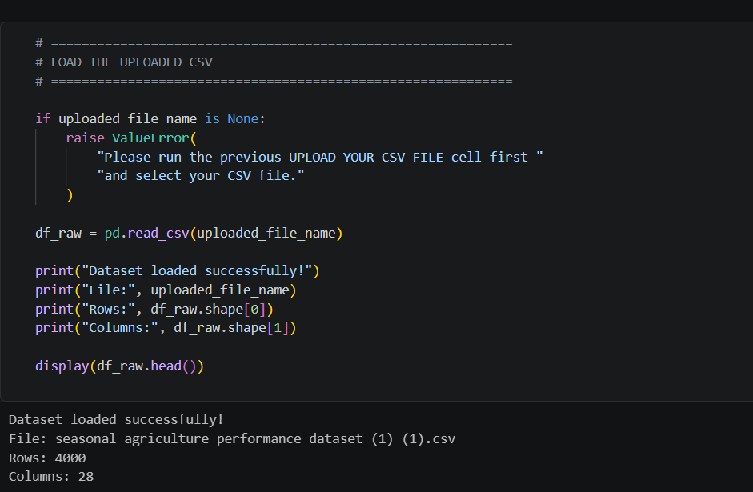
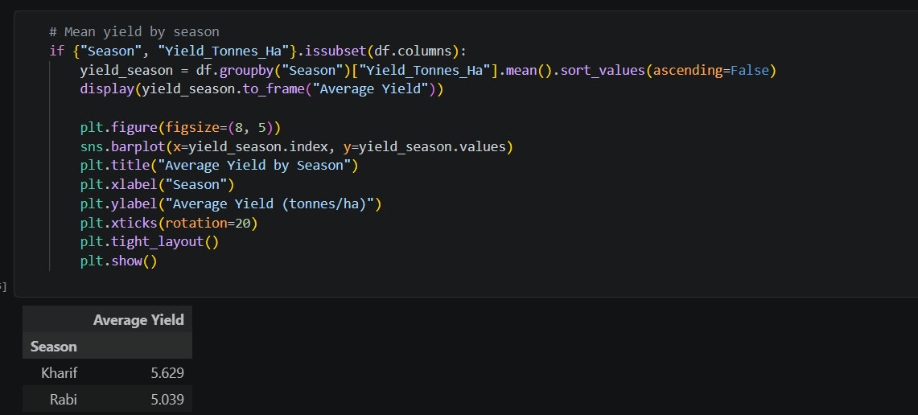
RESULTS

Slide 8
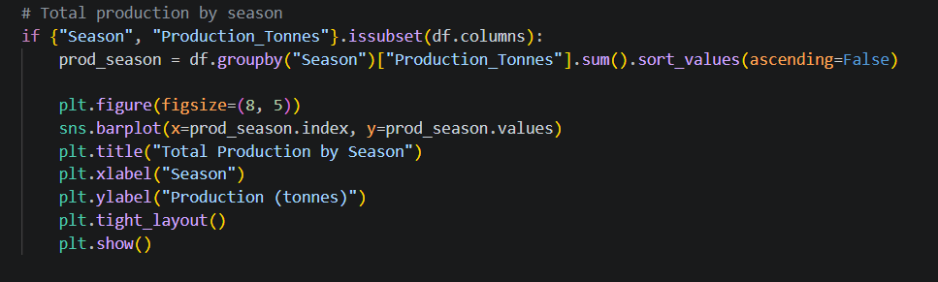
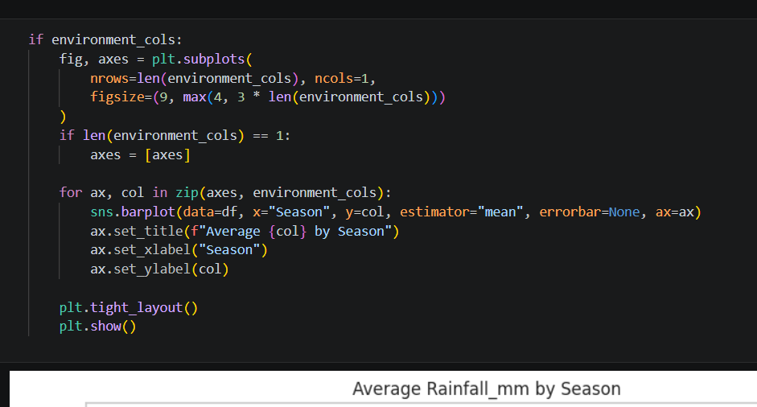
RESULTS

Slide 9
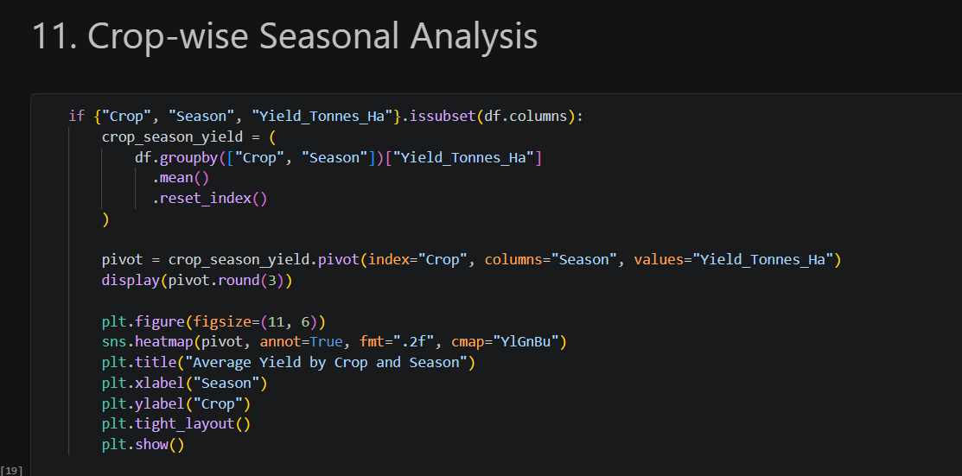
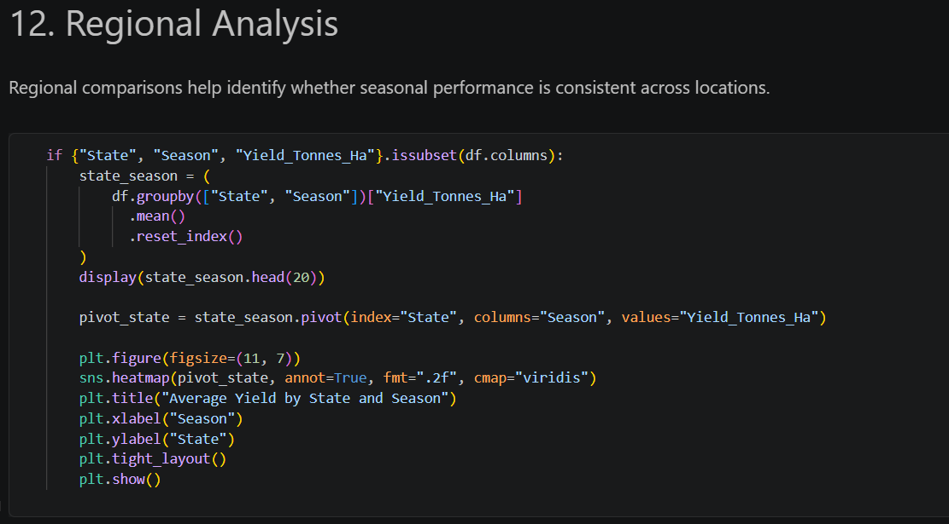
RESULTS

Slide 10
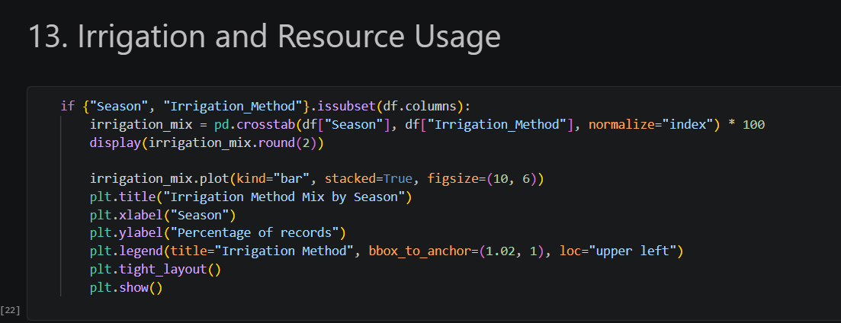
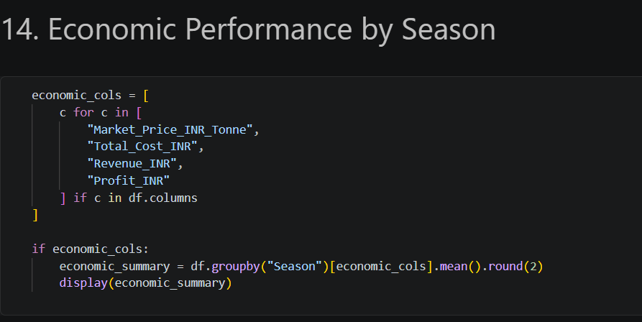
RESULTS

Slide 11
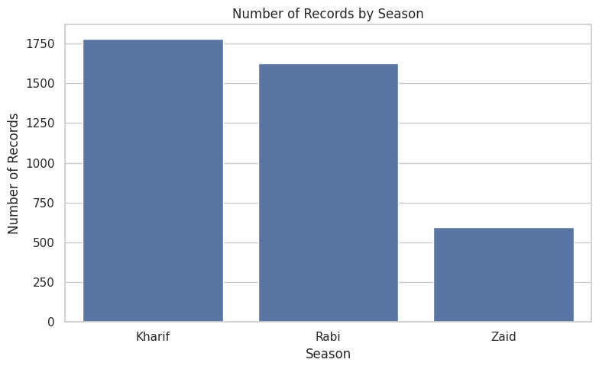
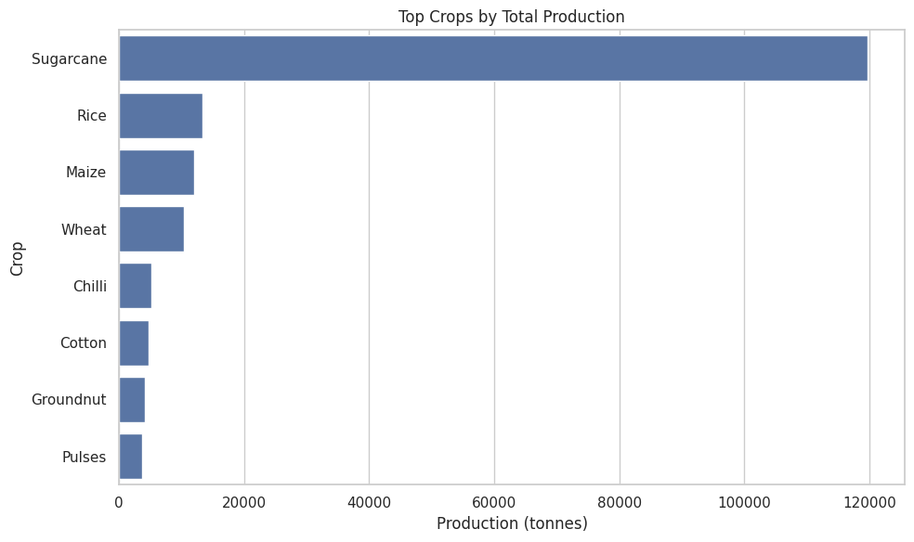
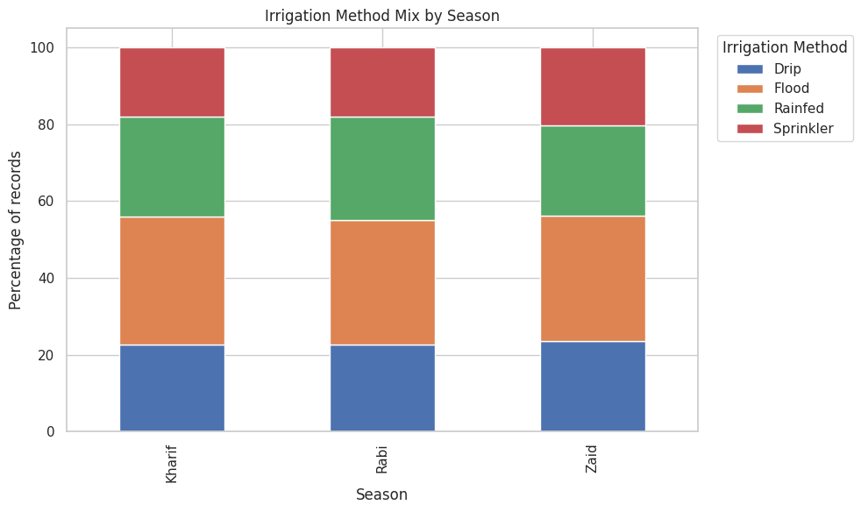
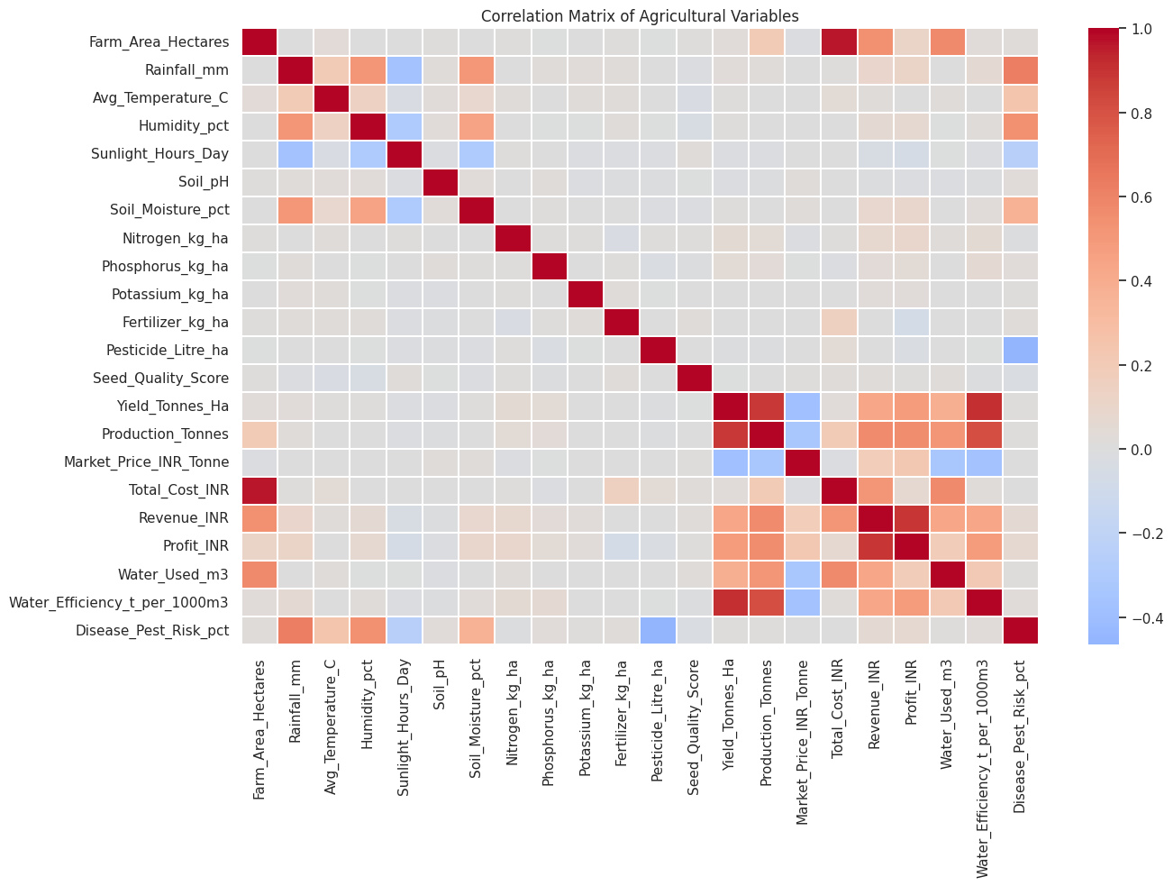
RESULTS

Slide 12
Future scope
Predict crop yield using Machine Learning.
Recommend the best crop for each season and region.
Add real-time weather data.
Analyze market prices and suggest profitable crops.
Help farmers save water and reduce costs.
Create a mobile/web application for farmers.
Add AI-based recommendations for better farming decisions.

Slide 13
GitHub Link
https://github.com/cpushpalatha9/Seasonal-Agriculture-Performance-Analysis

Slide 14

VOIS Course completion certificate -
Course name- Data Visualization

Slide 15
Thank you
.
.

